Slide 1

Analyzing Airbnb Pricing Dynamics in New york City
Clustering and Regression Analysis
Abrar Altaf Lone
Data Mining Fall 2025 72958
MS in Data Science
Pace University
Dec 16 2025
Notes:
This project explores how Airbnb prices in New York City are shaped by location, demand, and host behavior using data mining techniques.

Slide 2
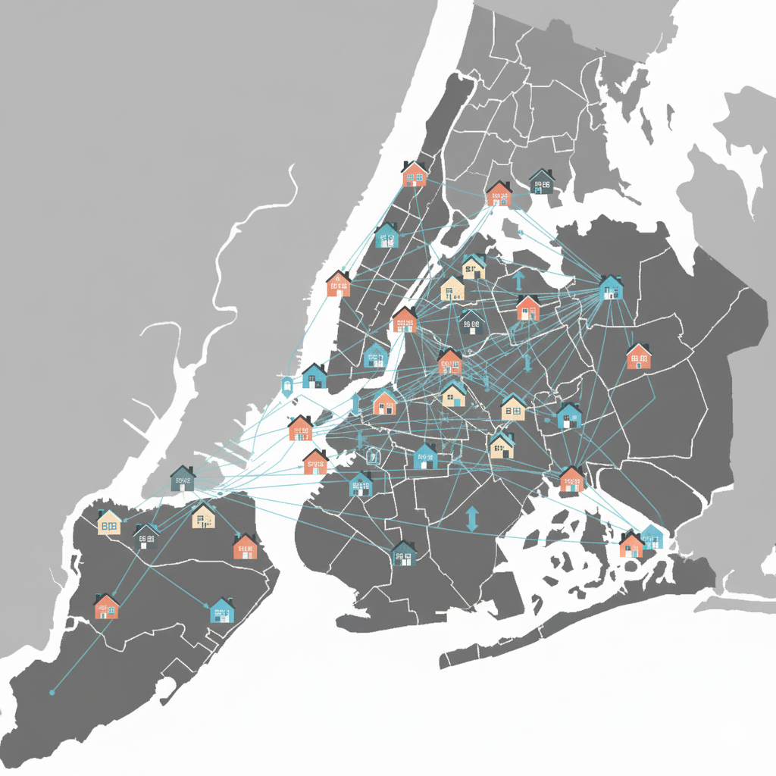
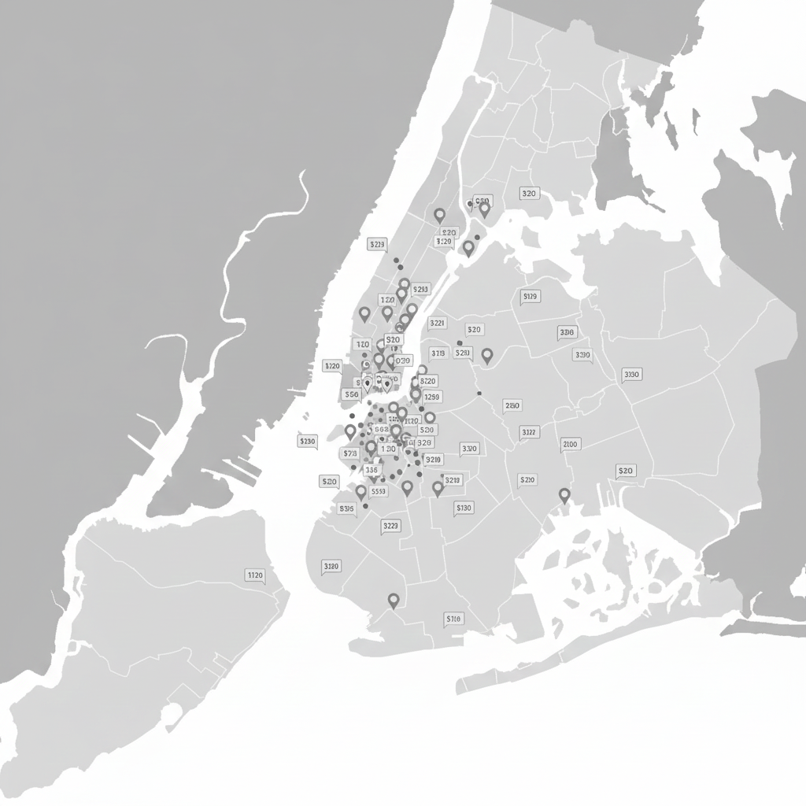
MOTIVATION
Why Study Airbnb Pricing?
NYC is one of the largest and most competitive Airbnb markets
Prices vary widely across neighborhoods and listing types
Pricing affects:
Hosts (revenue optimization)
Guests (affordability & choice)
Policymakers (housing regulations)
Understanding pricing behavior has real-world economic impact
Notes:
Airbnb pricing in NYC impacts hosts, guests, and policymakers, making it an important real-world problem to study.

Slide 3
Problem Statement
Airbnb prices in New York City vary significantly.
Pricing depends on multiple interacting factors:
Location
Room type
Demand and availability
Host behavior and regulations
These interactions make pricing difficult to model using simple rules or linear assumptions.
Notes:
The challenge is modeling Airbnb prices when multiple factors interact in complex, non-linear ways.

Slide 4
Objectives
This project aims to:
Explore Airbnb pricing patterns in New York City using exploratory data analysis
Segment listings into meaningful groups using clustering techniques
Predict listing prices using supervised learning models
Evaluate and interpret model performance and key price drivers
Exploratory Data Analysis
Clustering
Regression
Interpretation
Notes:
This project is structured around four main objectives.
First, I explore Airbnb pricing patterns in New York City using exploratory data analysis to understand distributions, variations, and key trends.
Second, I segment listings into meaningful groups using clustering techniques, which helps identify different types of Airbnb listings in the market.
Third, I build regression models to predict listing prices and compare a linear baseline with a non-linear model.
Finally, I interpret model performance and feature importance to understand the key drivers of Airbnb pricing.
Together, these steps form a complete data mining pipeline from exploration to interpretation.

Slide 5
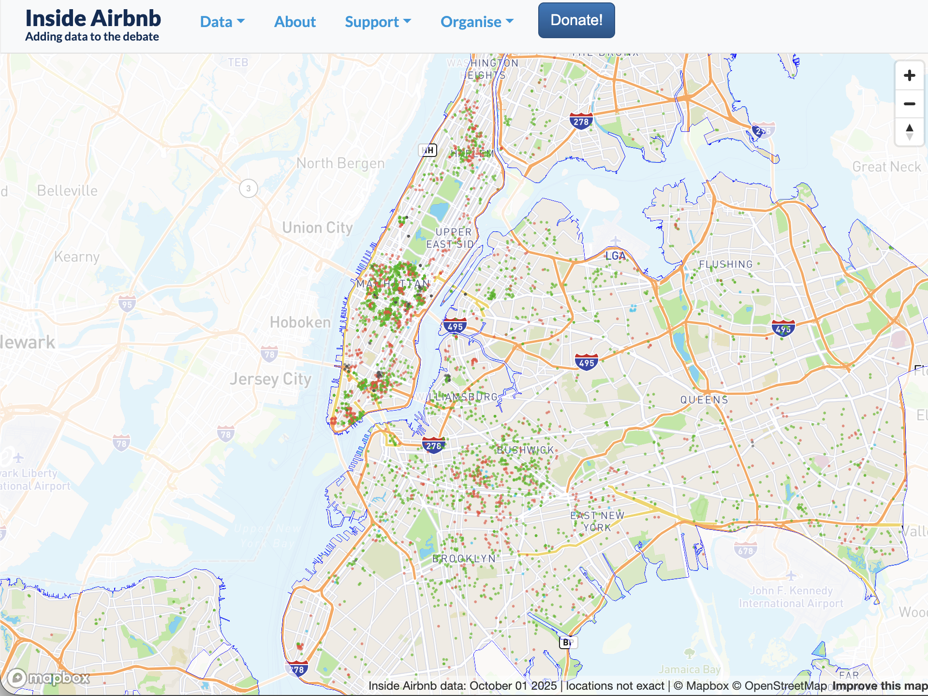
Dataset Overview
Source: Inside Airbnb (NYC listings)
Scope: New York City (5 boroughs)
Observations: ~20,900 listings (after cleaning)
Target Variable: Price (log-transformed)
Features: Location, room type, availability, reviews, host activity
Notes:
The dataset used in this project comes from Inside Airbnb and contains detailed information on Airbnb listings across all five boroughs of New York City.

Slide 6
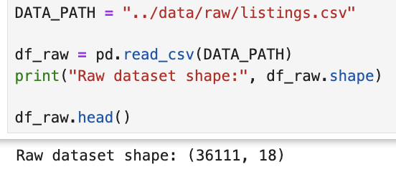
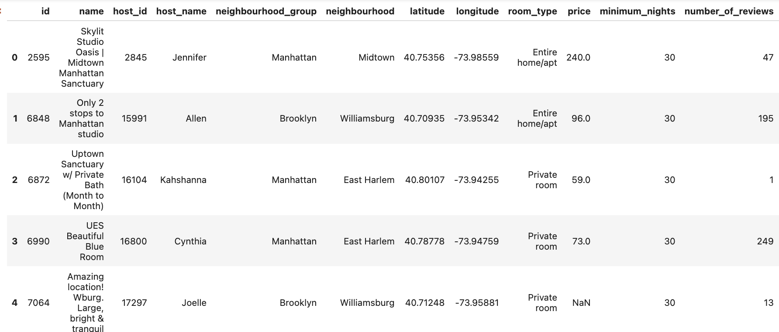
Notes:
After preprocessing and cleaning, we retained approximately twenty-one thousand listings. Each row represents a single Airbnb listing, with features related to location, room type, availability, review activity, and host behavior.
The target variable is price, which was log-transformed to reduce skewness and stabilize variance for modeling. This dataset provides a realistic and diverse view of the NYC Airbnb market.

Slide 7
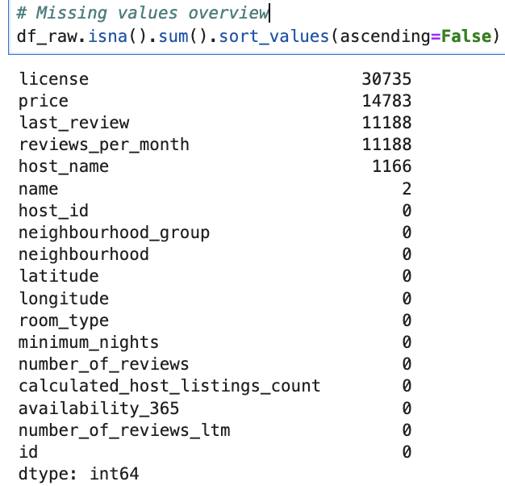
Data Preprocessing
Missing Value Handling
Removed listings with missing price
Imputed review-related fields with zero
Feature Selection
Dropped IDs, text-heavy, and irrelevant attributes
Retained pricing-relevant features only
Target Transformation
Applied log transformation to price to reduce skewness
Outlier Treatment
Removed extreme prices using IQR-based filtering

Slide 8
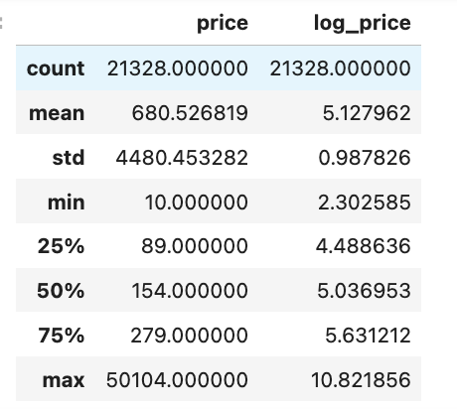
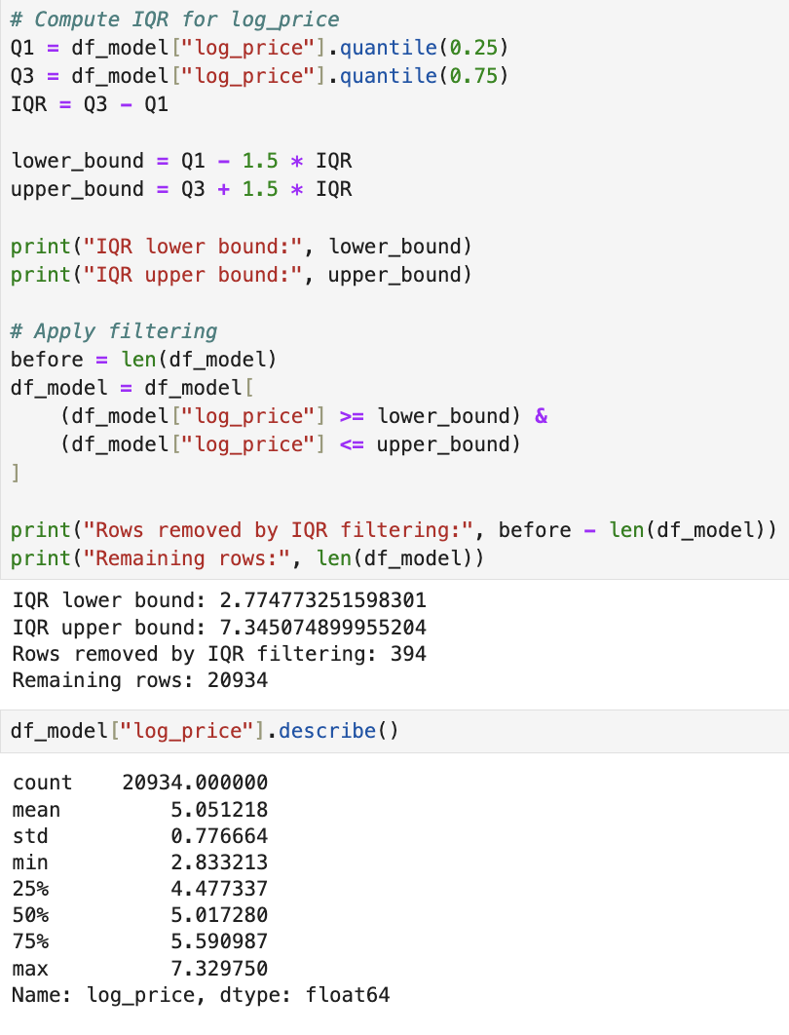
$16
$1500
Notes:
The price distribution is highly right-skewed with extreme outliers. A logarithmic transformation was applied to the target variable to stabilize variance and improve regression model performance.
The IQR-based bounds on the log-transformed price correspond approximately to listings priced between USD 16 and USD 1,500 in the original price scale. This range is reasonable for the New York City Airbnb market. Prices below this range are likely to represent data errors, inactive listings, or non-meaningful entries, while prices above this range correspond to luxury or atypical properties that are not representative of the majority of listings.

Slide 9
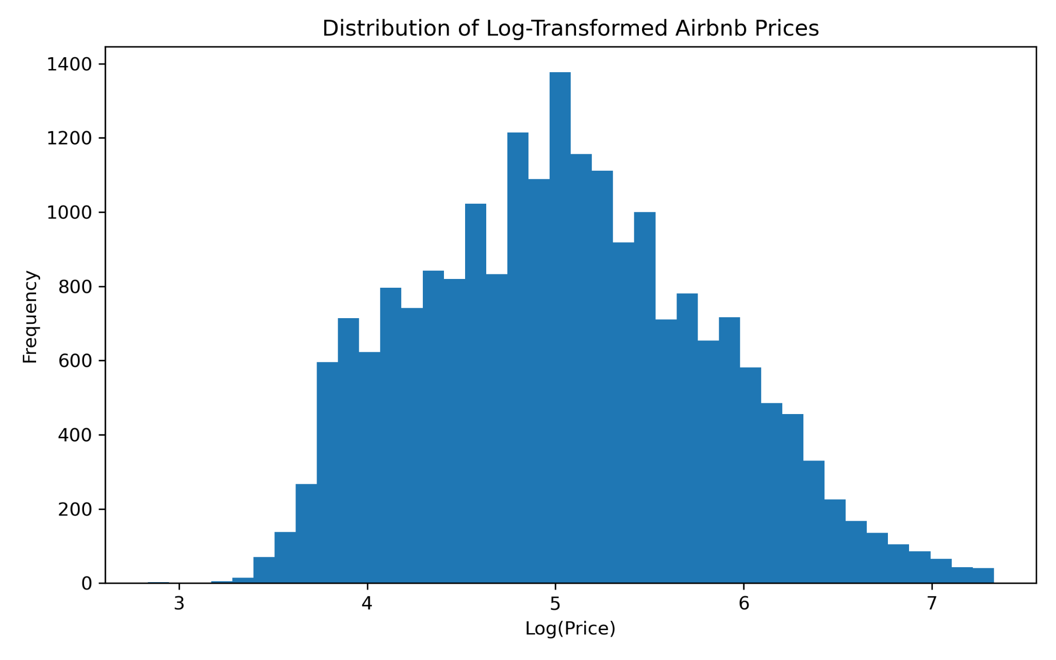
Exploratory Data Analysis
Price Distribution
Log-transformed prices exhibit a near-symmetric distribution.
Notes:
This histogram shows the distribution of log-transformed Airbnb prices.
As discussed earlier, raw prices were heavily right-skewed.
The log transformation reduces skewness and variance, making the data more suitable for clustering and regression models.

Slide 10
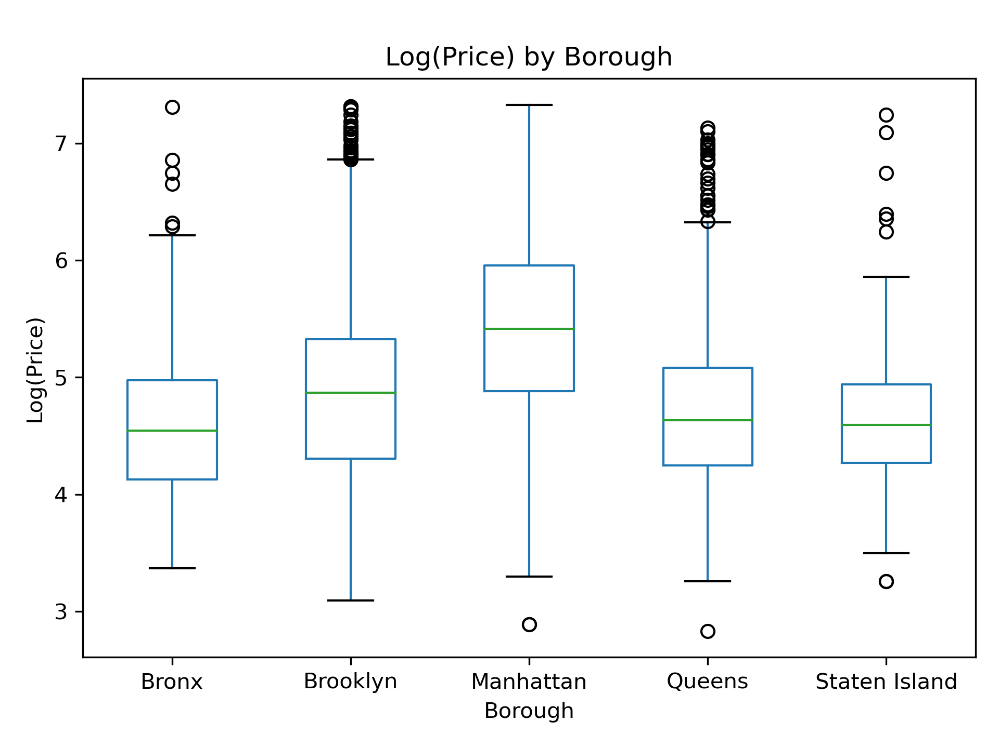
Price by borough
Manhattan shows highest median prices
Bronx has lowest median prices
Notes:
This boxplot compares Airbnb prices across New York City boroughs.
Manhattan listings are consistently more expensive and more variable, reflecting higher demand and location premiums.
Outer boroughs such as the Bronx and Staten Island exhibit lower median prices.

Slide 11
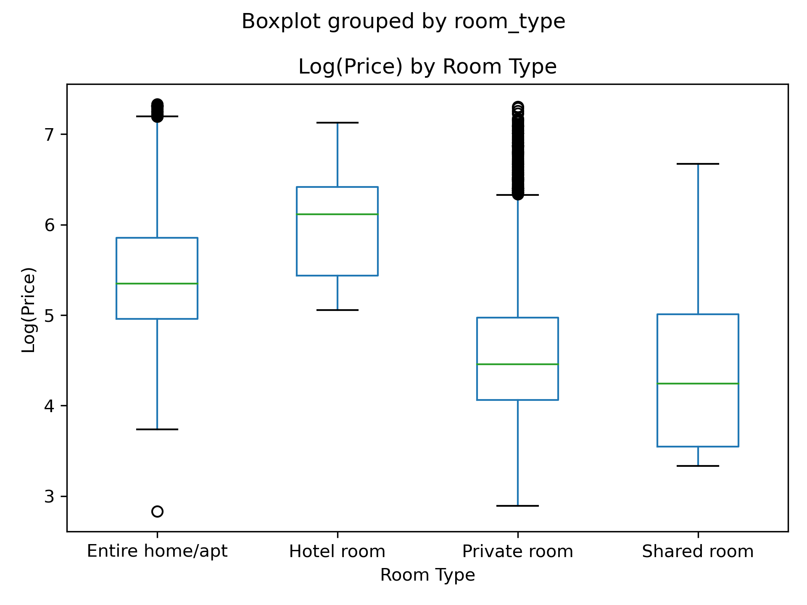
Price by room type
Entire homes & hotel rooms higher prices
Shared rooms lowest prices
Notes:
Room type plays a significant role in pricing.
Entire homes and hotel rooms command higher prices, while private and shared rooms are more affordable.
This confirms room type as a critical feature for modeling Airbnb prices

Slide 12
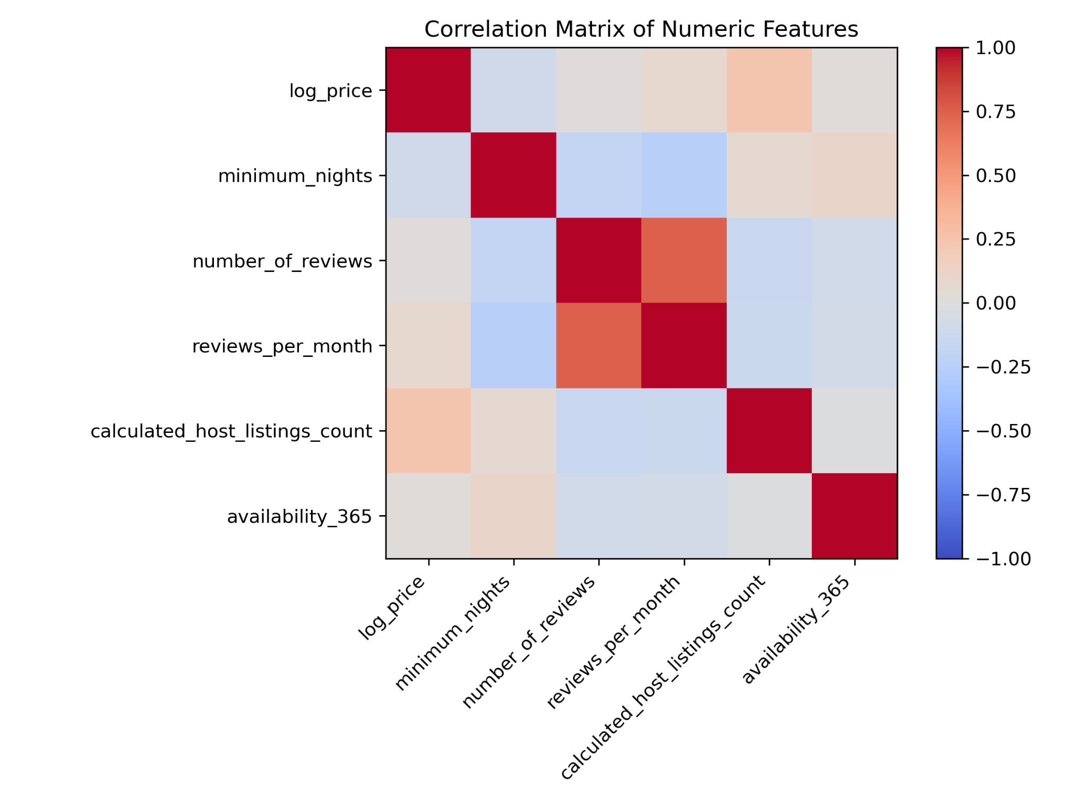
Correlation Analysis
Weak linear correlations
Suggest non-linear modeling
Notes:
Most numeric features show weak linear correlation with price.
This motivates the use of non-linear models such as Random Forests rather than relying solely on linear regression
EDA slides are done

Slide 13
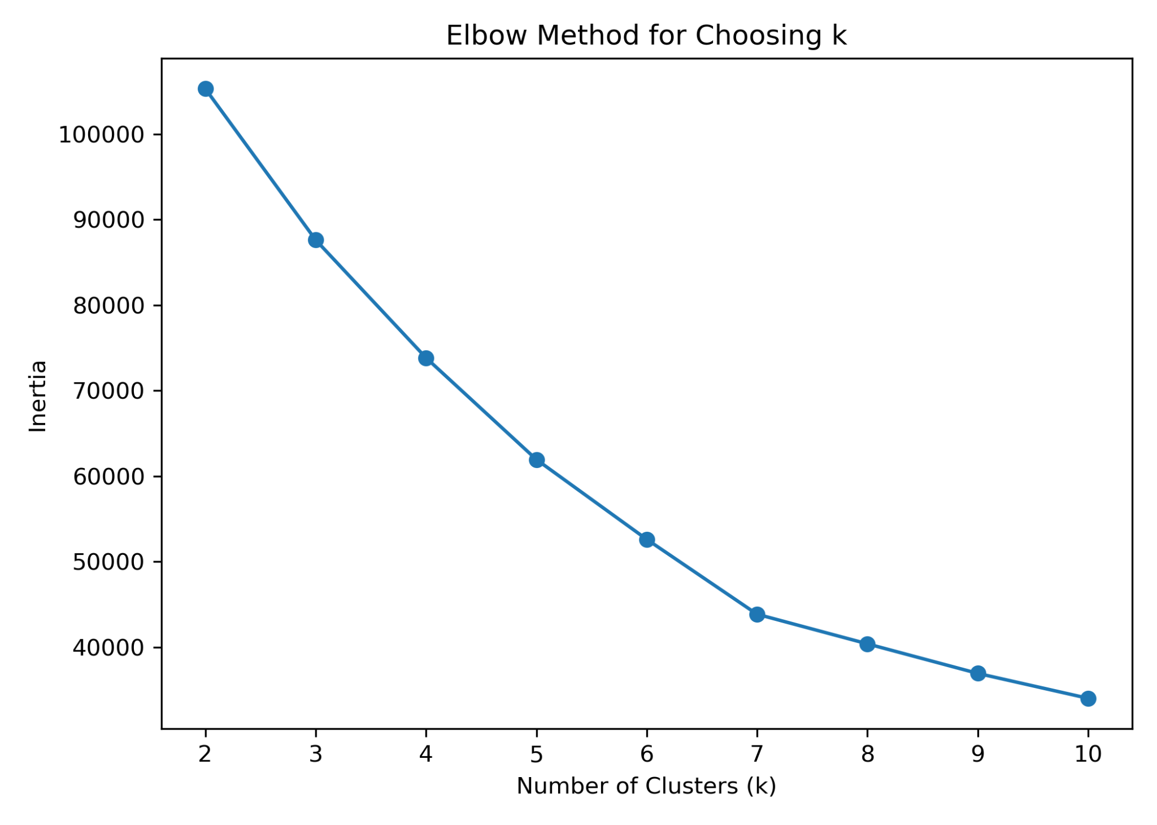
Clustering (Unsupervised Learning)
Goal: Identify natural segments among Airbnb listings
Method: K-Means clustering on standardized numeric features
Number of clusters selected using Elbow Method
Optimal k = 5 (diminishing returns beyond this point)
Notes:
From the elbow plot, we observe a steep drop in inertia as the number of clusters increases up to k = 5.
Beyond this point, the curve flattens, indicating diminishing returns.
Therefore, k = 5 was selected as it balances cluster compactness and interpretability.

Slide 14
Cluster Summary Statistics
Cluster | Size | Avg Log Price | Avg Min Nights | Avg Reviews | Avg Reviews/Month | Avg Availability
0 | 1029 | 6.06 | 31.24 | 0.17 | 0.01 | 224.99
1 | 5873 | 4.92 | 25.08 | 26.86 | 0.64 | 115.70
2 | 11910 | 5.00 | 28.80 | 16.59 | 0.38 | 321.48
3 | 2068 | 5.22 | 9.49 | 204.43 | 4.26 | 236.69
4 | 54 | 5.11 | 370.93 | 17.56 | 0.18 | 302.57
Five distinct clusters identified
Clusters differ by; price level, min. stay duration, review activity and availability
Clusters represent different market segments
Notes:
After selecting k = 5, we analyzed the characteristics of each cluster.
Each cluster represents a distinct type of Airbnb listing in New York City.
Some clusters correspond to budget or low-demand listings with high availability,
while others represent high-demand listings with frequent reviews and shorter stays.
We also observe a small cluster with very high minimum-night requirements, likely reflecting long-term or regulation-driven listings.
Overall, clustering helps us uncover natural market segments that are not visible from individual features alone.

Slide 15
Regression Models
Baseline Model: Linear Regression
Advanced Model: Random Forest Regressor
Input features include:
Location
Room Type
Availability & demand indicators
Target Variable: Log-transformed price
Model | R² | RMSE ( log price)
Linear Regression | 0.50 | 0.55
Random Forest Regressor | 0.72 | 0.41
Notes:
I first used linear regression as a baseline to model Airbnb prices.
While it captured some trends, its performance was limited due to the complex and non-linear nature of pricing.
We then applied a Random Forest Regressor, which can model non-linear relationships and feature interactions.
The Random Forest significantly outperformed the linear model, achieving a higher R² and lower RMSE.
This confirms that Airbnb pricing in NYC is driven by complex interactions rather than simple linear effects

Slide 16
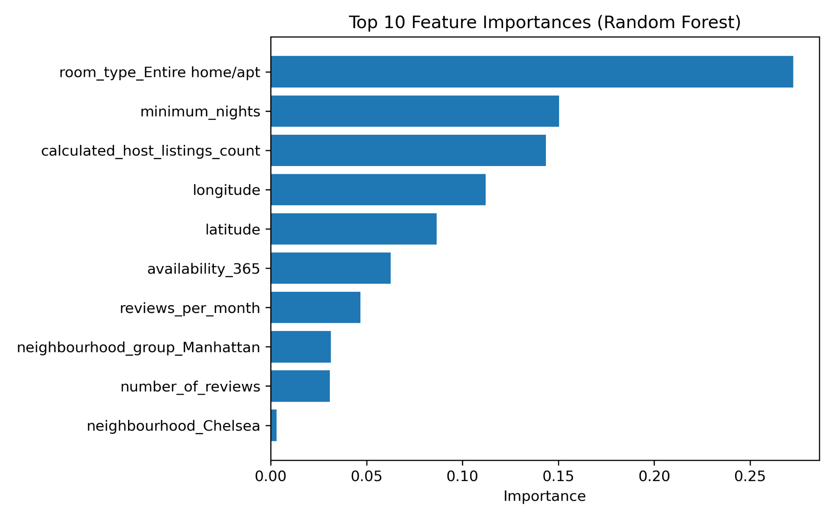
Feature Importance Analysis
Top Important Features:
Room type (Entire home/apartment)
Minimum Nights
Location
Pricing is driven by both location and listing characteristics.
Notes:
To interpret the Random Forest model, we analyzed feature importance scores.
These scores indicate how much each variable contributes to reducing prediction error.
Room type emerged as the most influential factor, especially entire homes and apartments.
Minimum nights and availability also play a major role, reflecting host pricing strategies.
Geographic features such as latitude and longitude capture location-based pricing effects.
Overall, the results confirm that Airbnb pricing depends on a combination of location, demand, and host behavior.

Slide 17
Conclusions & Takeaways
Airbnb pricing in NYC shows high variability driven by location, room type, and demand
Clustering revealed meaningful market segments among listings
Random Forest regression outperformed linear models, confirming non-linear pricing behavior
Feature importance analysis highlighted room type, minimum nights, and location as key drivers
Data mining techniques provide actionable insights into real-world pricing problems
Combining unsupervised + supervised learning leads to stronger understanding and prediction
Notes:
To conclude, this project analyzed Airbnb pricing dynamics in New York City using data mining techniques.
Exploratory analysis and clustering revealed distinct market segments among listings.
Regression results showed that non-linear models, particularly Random Forests, significantly outperform linear approaches.
Feature importance analysis further highlighted that pricing is influenced by a combination of location, room type, and host strategies.
Overall, this project demonstrates how data mining can be used to extract meaningful insights from real-world datasets

Slide 18
THANK YOU
Have a blessed winter

